Slide 1
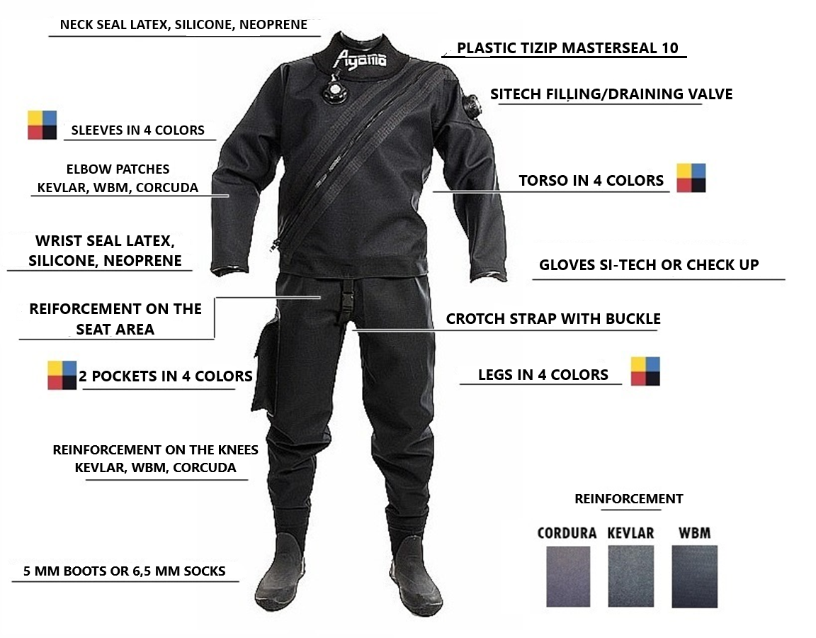
AGAMA EXTRA DRY TRILAMINATE SUIT

Slide 2
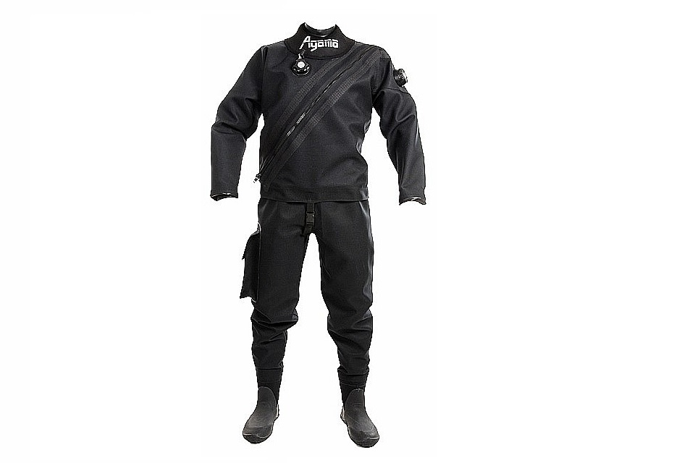
HOOD
NECK SEALS
VALVES
ZIP TIZIP
WRIST SEALS
GLOVES
REINFORCEMENT
EVERYTHING YOU NEED WITH ONE CLICK

Slide 3
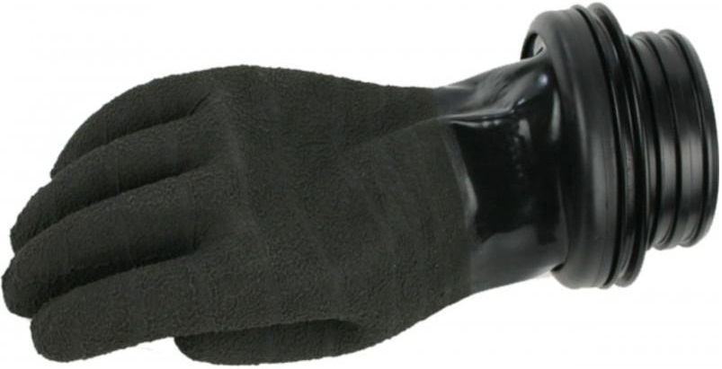
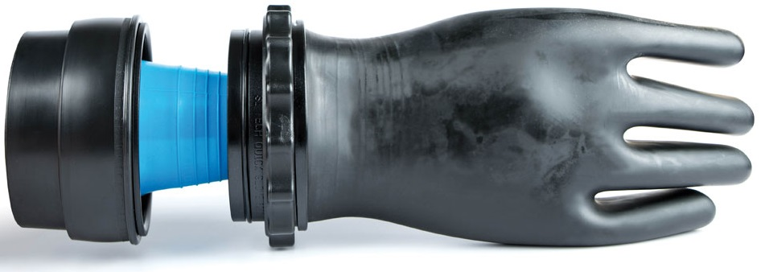
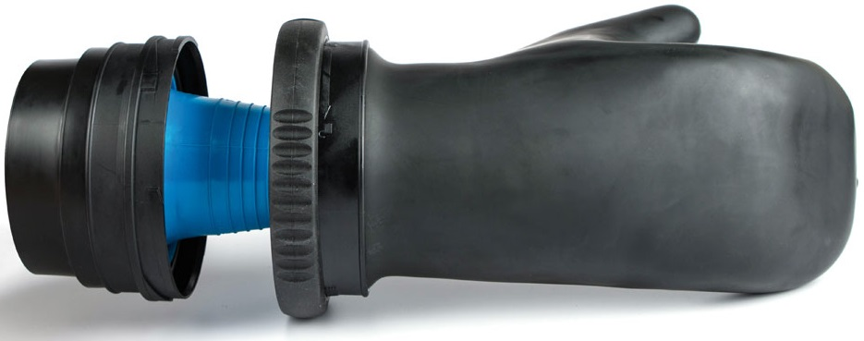
DRY GLOVES
CHECK UP
SI-TECH QUICK GLOVE
SI-TECH GLOVE LOCK
BACK

Slide 4
CHECK UP
Original Check-Up dry rubber gloves for attachment to dry suits, with non-slip surface. The price includes inner fleece gloves for insulation.
We also offer complete replacement parts for these gloves.
Separate plastic rings for wrist seals and gloves, Separate gloves, rubber O-rings, etc.
BACK

Slide 5
SI-TECH QUICK GLOVE
Versatile dry glove system with easy application for replaceable silicone seals. Easy to use, simply by inserting the rings. By screwing, the gloves can be easily detached.
*Outer diameter : 119 mm.
*Inner diameter : 90 mm.
Gloves are not included in the package.
We recommend SI-TECH dry gloves for this system.
BACK

Slide 6
SI-TECH GLOVE LOCK
SI TECH modular dry glove system. The system is compatible with interchangeable silicone wrist seals. The package does not include gloves. Outer diameter: 130 mm. Inner diameter: 93 mm. Can also be used with latex seals. The system offers the option to secure the gloves with a locking mechanism. We recommend SI TECH dry gloves for this system.
BACK

Slide 7
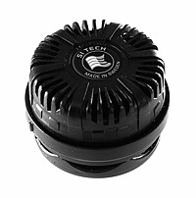
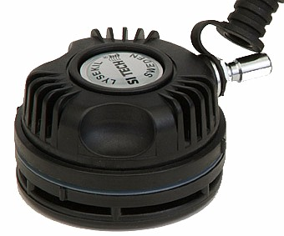
SI-TECH VALVES
INFLATION VALVE:
SHELL type. We recommend purchasing a rubber grommet and
a plastic washer for the valve.
DEFLATION VALVE:
ARGO type (low-profile, semi-automatic). We recommend purchasing a rubber grommet and
a plastic washer for the valve.
BACK

Slide 8
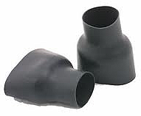
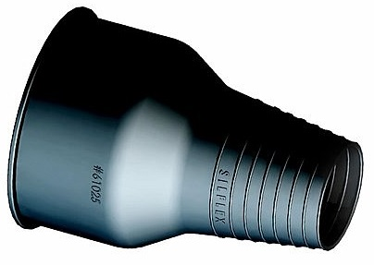
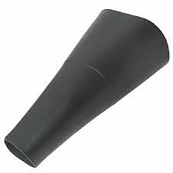
WRIST SEALS
SILICONE:
Equipped with rings (grooves) for trimming. 100% resistant to UV and ozone. Suitable for individuals with a latex allergy. 2 sizes:
Small: 10.6-15 cm (available on order)
Standard: 13.2-17 cm (in stock).
LATEX:
Heavy-duty wrist seals for dry suits in bottle shape.
CONICAL:
Original latex seals from England. The STANDARD size can be adjusted by trimming to suit the customer's needs. The approximate wrist circumference for the STANDARD size is 13 cm.
BACK

Slide 9
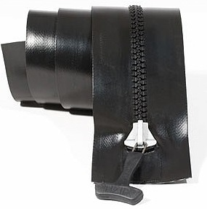
TIZIP MASTERSEAL
Made from high-strength fabric coated with thermoplastic polyurethane. Heavy-duty plastic teeth are secured with tape. The zipper fasteners keep the sealing edges airtight. The tapes are welded and glued. The slider is made of a metal alloy that does not cause irritation and is resistant to saltwater. When in motion, the slider does not touch the tapes or sealing edges, preventing fabric abrasion from frequent use. The zipper is very flexible, lightweight, and resistant to many types of damage; even pinching or contamination is not an issue. Maintenance is simple, requiring only water and a brush. Proper lubrication and ensuring the zipper is fully closed and locked is important.
BACK

Slide 10
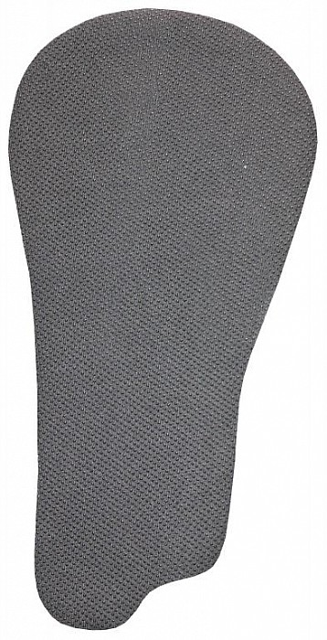
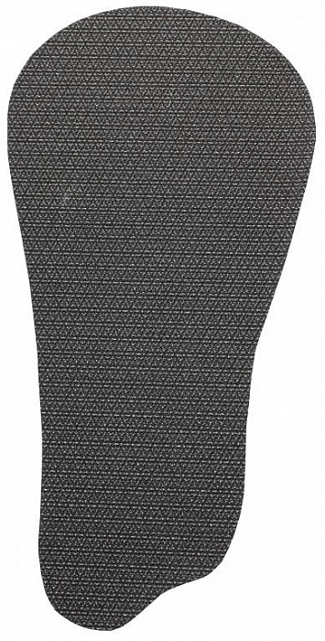
REINFORCEMENT
WBM:
Special iron-on material that you can apply yourself with an iron. Suitable for divers, kayakers, fishermen, and all similar sports where neoprene parts are subjected to stress. The application is ideal for areas such as knees, elbows, the seat area, or for repairing small tears. The material can be cut with scissors to the desired shape and size.
KEVLAR:
The application is ideal for use on the knees and elbows. It can be cut with scissors to the desired shape and size. The application is sewn and glued onto the suit – we recommend having it applied by us or a professional.
CORDURA:
Double reinforcement of the suit, preventing damage or tearing of the dry suit itself.
BACK

Slide 11
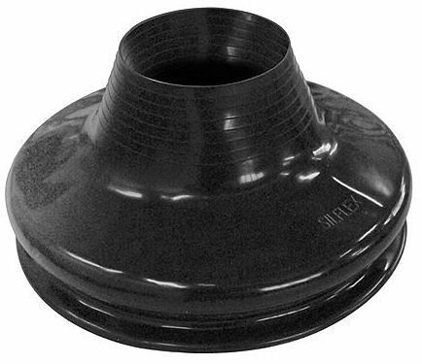
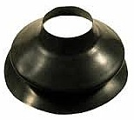
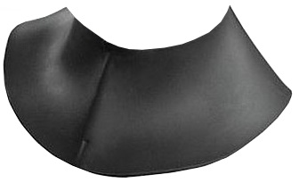
NECK SEALS
SILICONE:
Equipped with rings (grooves) for trimming. 100% resistant to UV and ozone. Suitable for individuals with a latex allergy. 2 sizes:
Small: 22-30 cm
Standard: 28-37 cm (in stock).
LATEX:
The seal is available in Small and Standard sizes. The size can be adjusted by trimming the seal. We recommend having the adjustments made at an authorized service center.
NEOPRENE:
Very popular seal due to its easy application. It is necessary to measure the neck circumference over the Adam's apple beforehand.
BACK

Slide 12
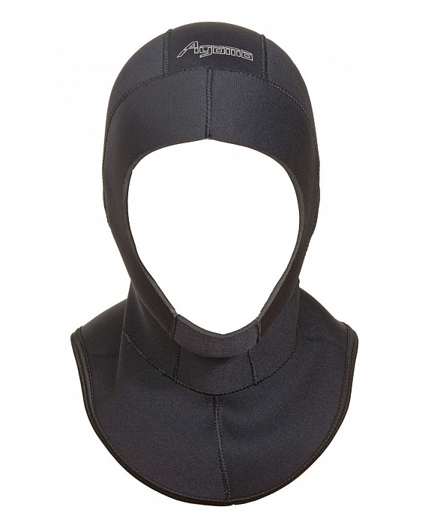
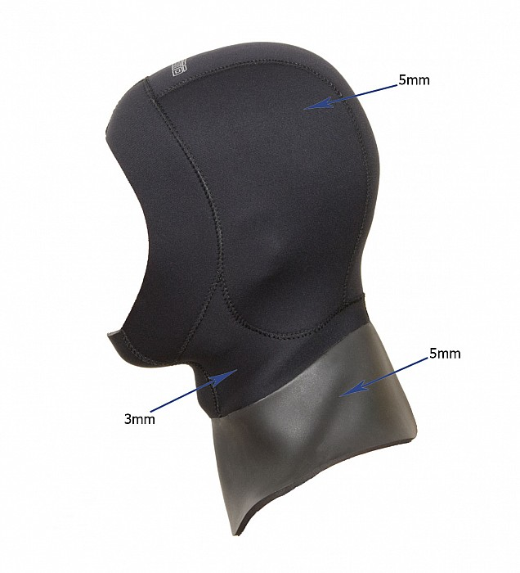
HOOD
INTEGRATED:
6.5 mm or 5 mm. With a facial seal. Smooth face seal on the inside or outside, preventing water entry.
WITHOUT HOOD:
We recommend purchasing the MIKY 5mm hood. It is suitable for all dry suits.
BACK

